Slide 1

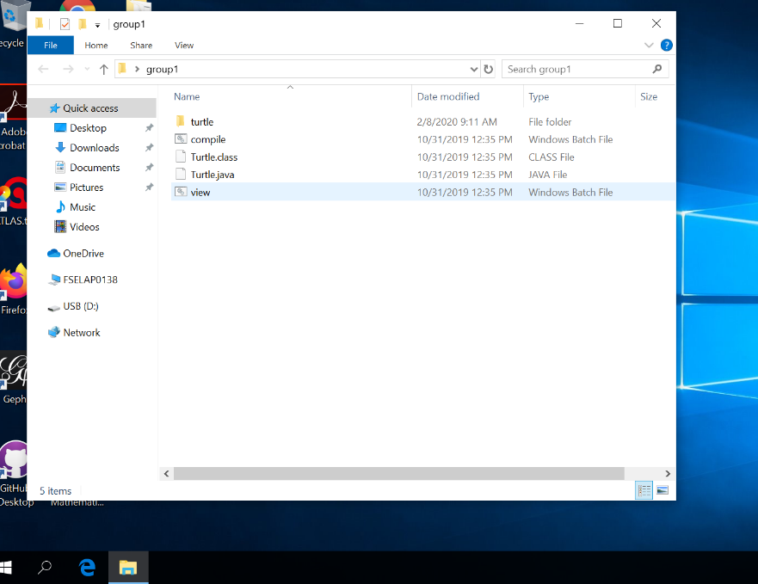
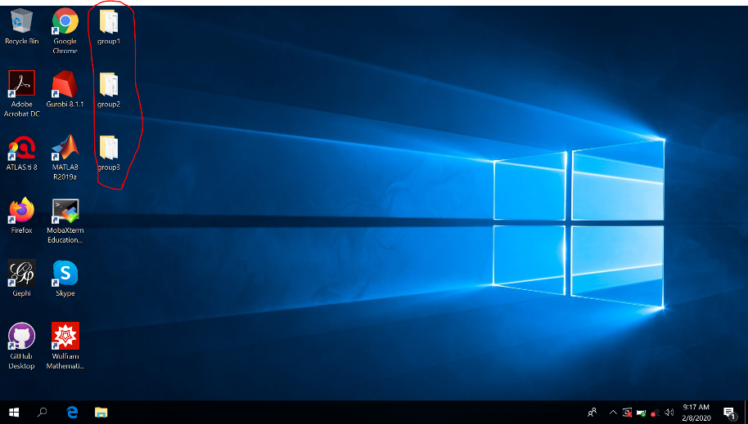
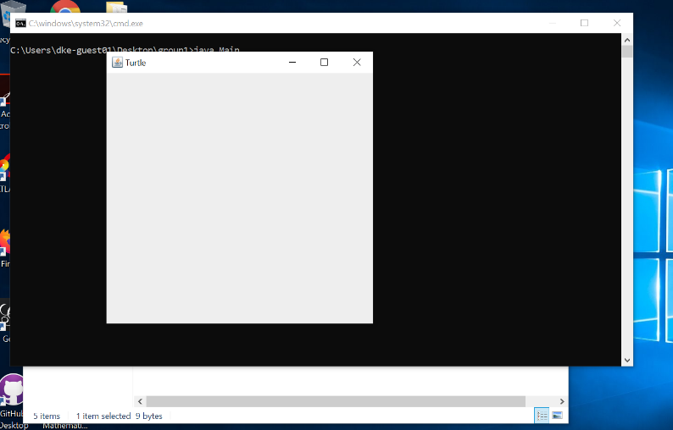
Programming exercise - Instructions
Login: User: DKE-GUEST01
Password: #BOD@work!2019$
2) Open your group folder:
3) Write code in “turtle.java” (open with Notepad)
4) Once you want to test: save “turtle.java” (ctrl+s) -> run “Compile” -> run “View”
5) If everything is fine you should see something like this (+some drawings) :
Nb: do not change the first line. It should be “…extends Frame” and not “extends Turtle.JavaApplet”

